Slide 1

Using PET-CT to in treatment response
Prof John Buscombe

Slide 2
Introduction
Monitoring response in Lymphoma
Early observations
Deauville response
Lugano criteria
Response in solid tumours

Slide 3
Looking for response
Though response accepted in lymphoma
Criteria less clear in solid tumours
Complication of inflammation
FDG may not be best tracer but no agreement on what is best tracer
No clear agreement on criteria for response
EORTC
PERCIST
Problem with tumours <5mm

Slide 4
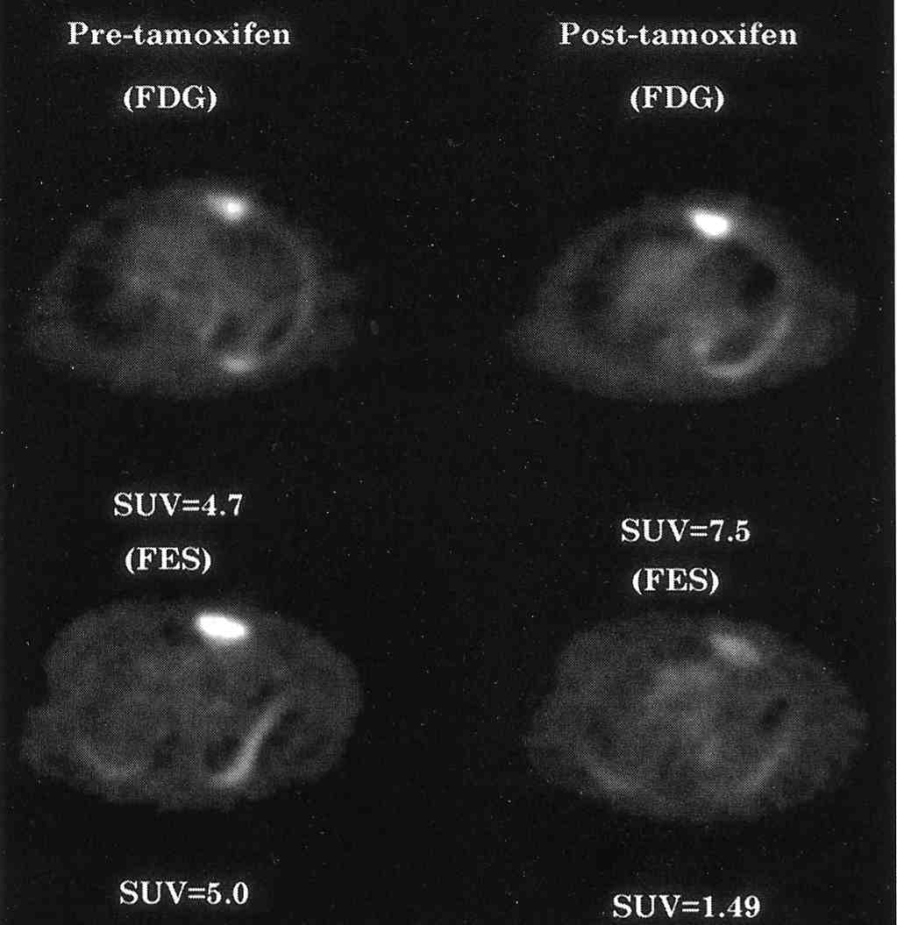
F-18 FDG vs F-18 FES in Ca Breast

Slide 5
Looking at response
At simplest it is looking the F-18 FDG PET scan before treatment
Comparing with post treatment scan
Can use SUV to help decision making
As SUV can vary often use a reference site
Use of F-18 FDG PET to look at outcomes based on work by Jerusalem at al

Slide 6
Progression free survival related to PET response
100%
PFS
50
Duration months

Slide 7
Basis of UK practice
Work done by Hutchings and Barrington
Look at standardising response assessment
Use of liver and mediastinal reference points
Then consensus conference in Deauville, France
Criteria for response laid out

Slide 8
Deauville criteria
Score* | Characteristics Based on SUVmax in lesion, liver and mediastinum
1 | No uptake
2 | Uptake < mediastinum
3 | Uptake>mediastinum<liver
4 | Uptake moderately more than the liver uptake, at any site
5 | Markedly increased uptake at any site and new sites of disease.
X | New areas of uptake unlikely to be lymphoma
Grade 1 and 2 not tumour, 3 equivocal, 4-5 tumour still present

Slide 9
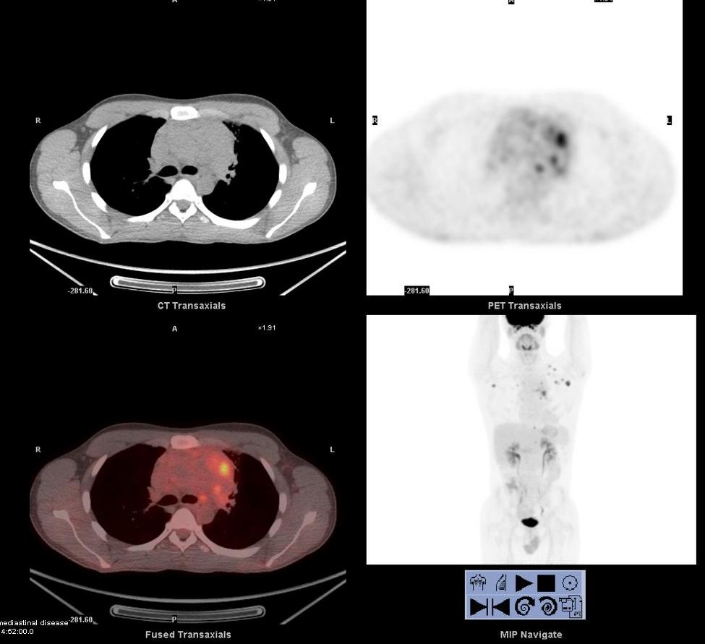
HD Clearly failed Tx Deauville 4

Slide 10
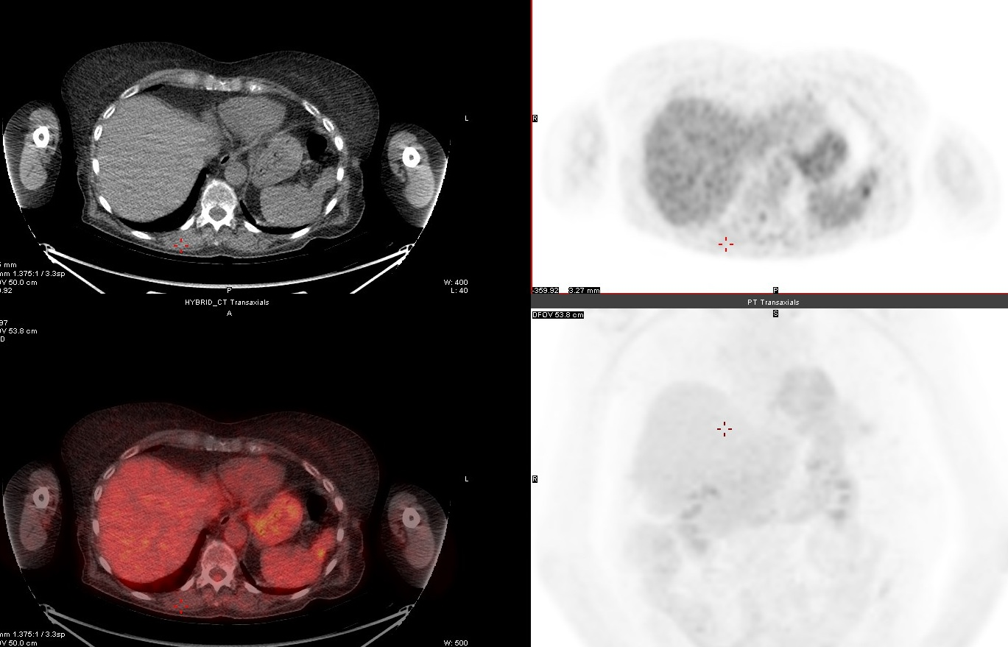
A subtle failure note spleen

Slide 11
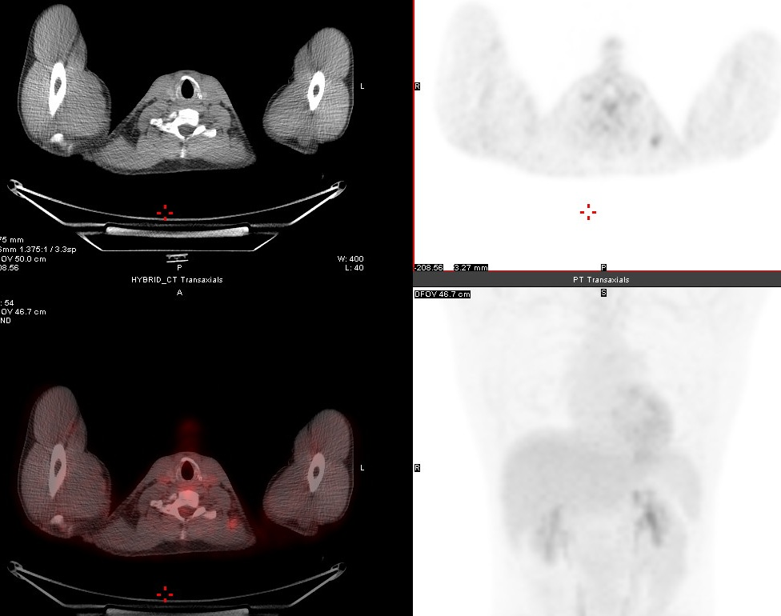
Is this active disease ?D3

Slide 12
Lugano criteria 2020
Primarily for DLBCL
Based on Deauville criteria again scan 6 weeks last Tx
Also includes CT
However, recommends pre therapy FDG PET-CT
Complete metabolic response Deauville, 1, 2,3 residual mass allowed
This allows grade 4 and 5 response to be Partial MR if uptake or size less than pre-therapy level.
Likewise Metabolic Stable Disease is grade 4 and 5 and no change in SUV
Progressive disease, grade 4 and 5 with increase in SUV or increase in tumour size on CT
Lugano also states that if FDG PET disagrees with CT the FDG-PET, then PET trumps CT

Slide 13
Some issues
Need to be consistent with placing of ROIs
Care when using TOF images that mediastinal blood pool does not clip aorta wall which can have high uptake
What to do with liver and non-homogeneous activity
Most sample 2-3 sites and take mean
Therefore, the system is not precise but is pragmatic

Slide 14
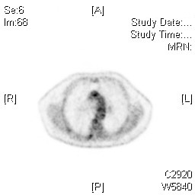
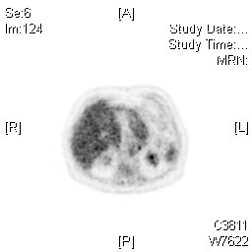
Site for ROI
Aortic blood pool ROI needs to avoid wall of the aorta
Liver uptake non-homogeneous where to put ROI

Slide 15
EARLY TREATMENT EVALUATION
PET predicts prognosis after initial treatment
1 cycle Kostakoglu et al, J.Nucl.Med., 2002
1-2 cycles Torizuka et al, EJNMMI, 2003
2 cycles Zijlstra et al, Br.J.Haematol., 2003
2-3 cycles Jerusalem et al, Haematologica, 2000
2-4 cycles Mikhaeel et al, Leuk. Lymphoma, 2000
3-4 cycles Spaepen et al, Ann. Oncol., 2002

Slide 16
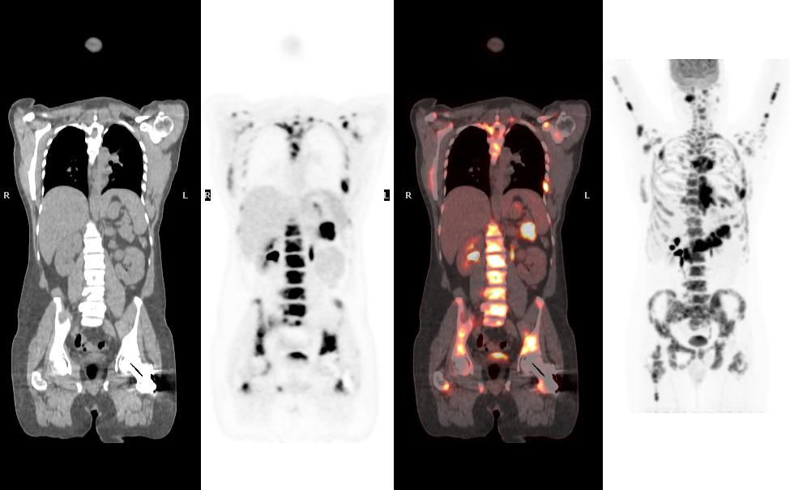
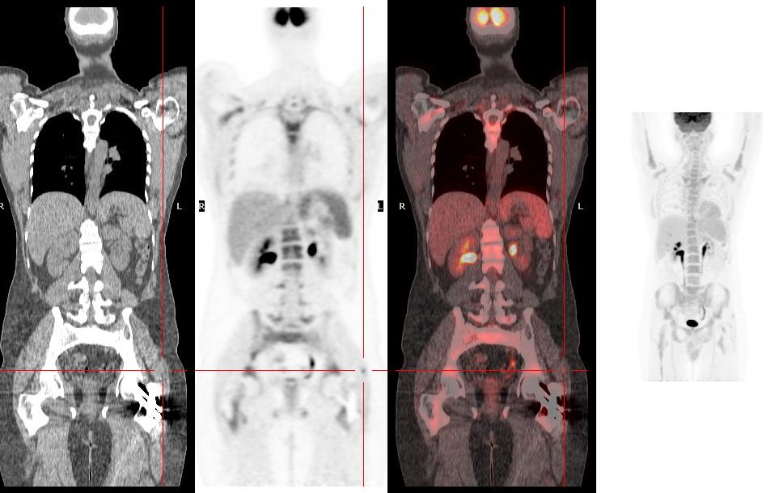
Measuring response -25 yr male HD induction chemo
Pre treatment
After a 2 doses of chemotherapy

Slide 17
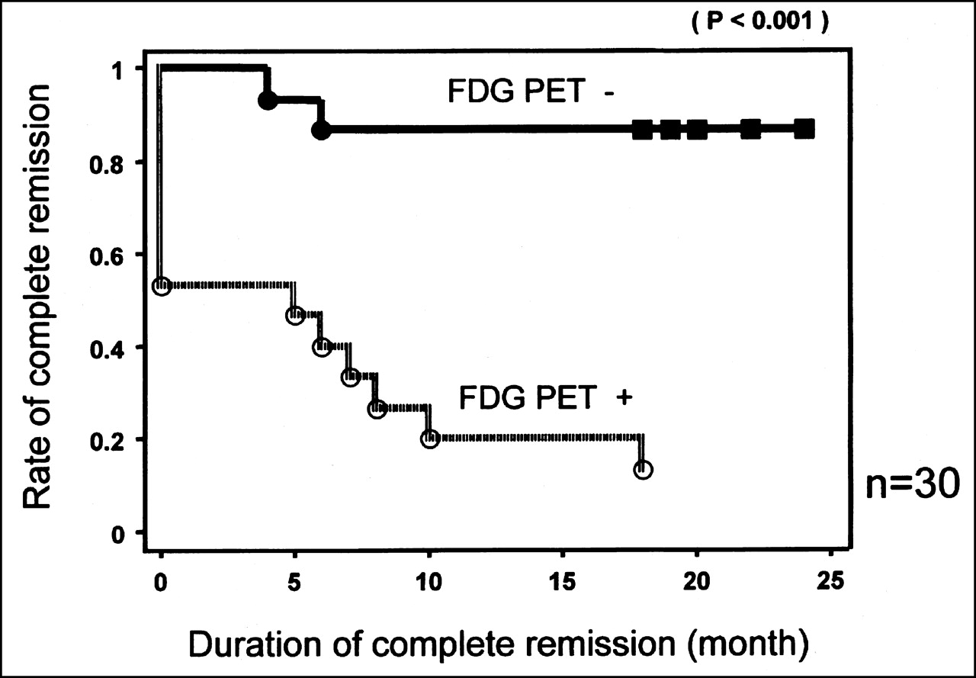
F-18 FDG PET after 1st cycle in ABVD in HD
Kostakoglu et al, J Nucl Med 2002

Slide 18
Early response in HD
Gallamini et al Joint Italy/Danish study JC0 2010
290 patients with HD
2 cycles of ABVD
International prognostic score
F-18 FDG PET
Both compared to final result as assessed at 6 weeks after all treatment (normally 6 cycles)

Slide 19
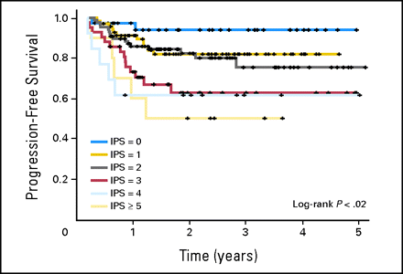
Gallamini et at IPS

Slide 20
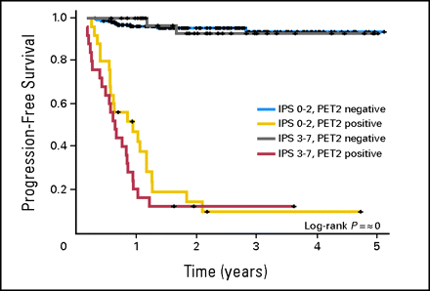
Gallamini F-18 FDG PET vs IPS

Slide 21
Present situation
A negative F-18 FDG PET 6 weeks after last cycle is now accepted as goods prognostic sign
Role of interim PET-CT less clear as most data on HD
Also if positive what do you do
Give more intensive treatment
Give different treatment
Give up
How do you assess 2nd choice treatment

Slide 22
Is Deauville out of date?
Over reliance on SUVmax
SUVmax can be unreliable measurement of real activity as does not reflect whole organ
Use of resolution recovery and scatter correction smooth out organ activity so SUVmax in liver, spleen and blood pool lowered so more patients will fail treatment as even low level node uptake
So need to reconstruct images twice
TOF for Deauville
RR for reporting

Slide 23
PRoLoG
Consensus between Europe and North America JNM 2023
FDG prime method of measuring response
Lugano criteria base for both predicting response and post treatment outcomes
As well as changes in FDG measurement spleen size also seen as important esp if spleen is greater than 13cm
Bone marrow sampling before and after therapy may be useful when pre-treatment scan shows

Slide 24
Response criteria in solid tumours
Little consensus
Most techniques more complex and time consuming than Deauville
Two main methods
Total glycotic volume (TGV)
PET response criteria in solid tumours (PERCIST)
Both are time consuming
Used in some research but less used clinically
Simpler metabolic tumour volume (MTV) less clear how useful this is

Slide 25
Total glycotic volume (TGV) and Total lesion glycolosis (TLG)
The concept is simple
Take each voxel with FDG uptake and the SUV of that voxel and then do the same for each voxel with FDG uptake
Based on metabolic tumour volume
Add together SUVs and you get a number this becomes the Total Lesion Glycolosis use the SUVmean to get total glycotic volume
The total of SUV/pixel is the total lesion glycolosis (TLG)
Tends to be favoured in Europe
However, many variables such as type of PET scanner reconstruction and filtering
How ROIs are drawn
May really need to be done by AI to be reproducable

Slide 26
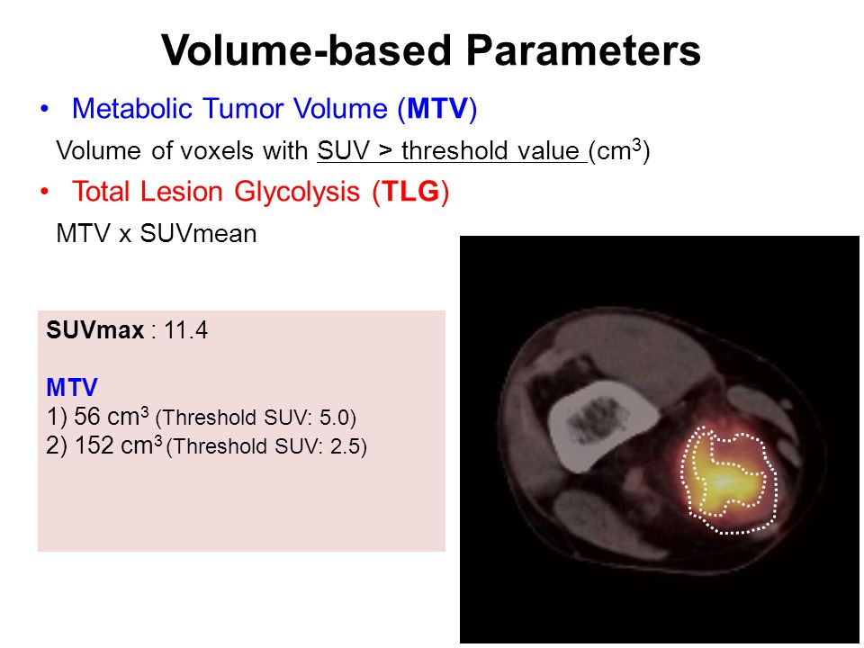
MTV and TGV
Ogawa et al Anti Can Res 2015

Slide 27
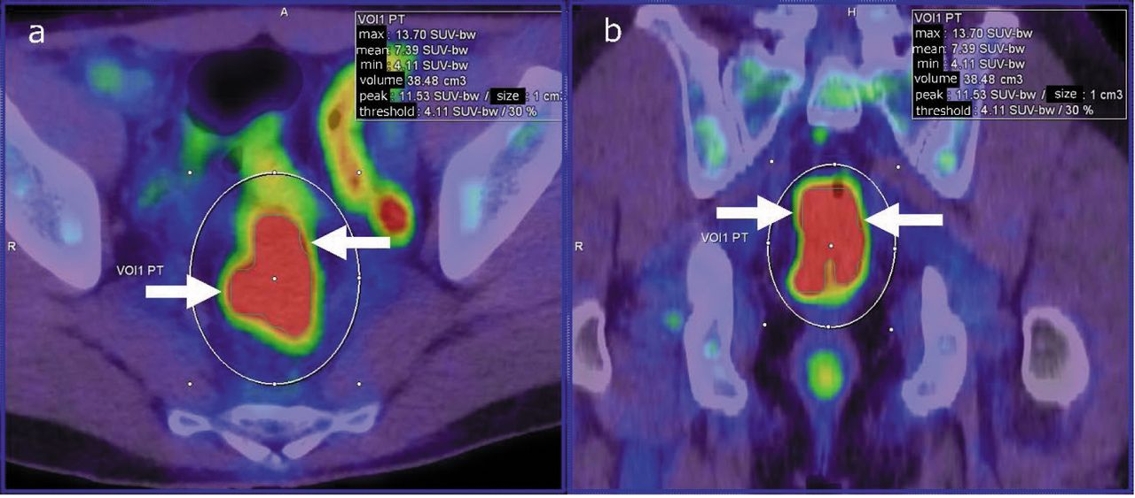
TGV in colorectal cancer
Ogawa et al Anti Can Res 2015, showed high GTV related to poorer prognosis

Slide 28
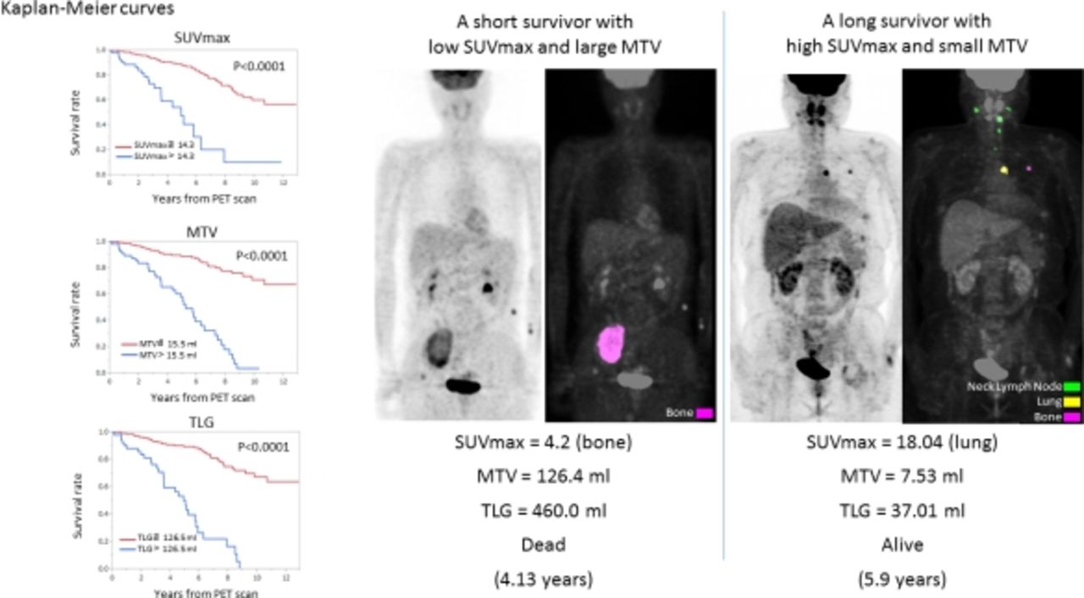
MTV predicting better survival than SUV in iodine neg thyroid Ca
Uchiyama et al JNM 2016

Slide 29
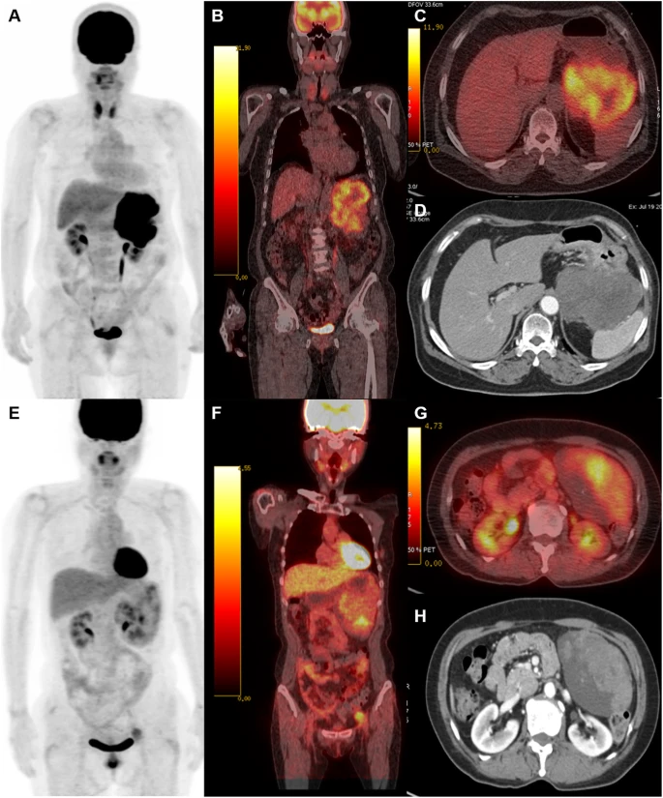
Use of FDG to monitor response in GISTs
Hwang et al Cancer Metab 2021
Prospective trial in GIST patients
Used MTV and TLG to monitor response
Pre therapy MTV was 700cc and TLG was 4350 g
Post therapy MTV was 77cc and TLG was 222g

Slide 30
PERCIST
PET Response Criteria in Solid Tumours
Developed in USA
Based at Johns Hospkins
Based on higher sensitivity of PET
Discussion of methods
SUVmax
SUVmean
Glycolytic volume

Slide 31
Basic methods
SUVmax too variable
SUVpeak may not include most active tumour
PERCIST using a volumetric 1cm³ voxel
Corrected for biodistrubtion and patient lean metabolism measured with 3.5cm³ voxel in normal liver the SUL

Slide 32
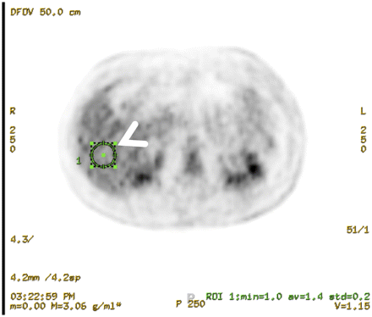
Liver voxel for correction
Example calculation of liver background for normalization of SUL. Images are displayed from Advantage Workstation (GE Healthcare). A 3-cm-diameter 3-dimensional ROI (ROI 1) is placed on normal inferior right lobe of liver (arrowhead). Average SUL and SD in ROI are displayed (arrows). Liver background is calculated as follows: (1.5 × average SUL liver) + (2 × SD average SUL liver). For this example, (1.5 × 1.4) + (2 × 0.2) = 2.5. Therefore, tumor SUL peak should be >2.5 in order to apply PERCIST criteria for this example

Slide 33
Criteria for PERCIST
Normally done after 3 cycles of chemo
Compare with baseline (at baseline Tumour SUL>2.5)
SUL liver between 2 sd of baseline
100% reduction CMR
>30% reduction PMR
>30% increase MPD
Rest MSD

Slide 34
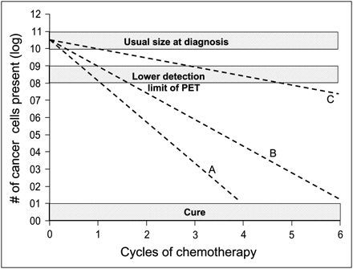
PET detects small lesions
Kinetics of tumor cell kill and relation to PET. Line A represents brisk tumor response that would produce cure after only 4 cycles ofchemotherapy. Line B represents minimum rate of tumor cell kill that will lead to cure in 6 cycles of treatment. Both lines would be associated with negative PET scan after 2 cycles of chemotherapy. In contrast, line C represents rate of tumor cell kill that would be associated with negative PET scan after 4–6 cycles but would not produce cure. Importantly, PET scan for line C would likely be positive after 3 cycles

Slide 35
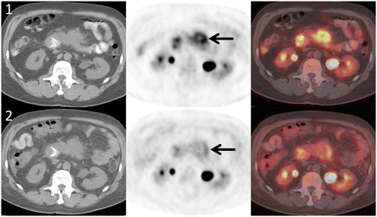
An example Wahl et al
PET/CT images obtained before (1) and after (2) treatment ofpancreatic carcinoma with experimental therapy targeting mammalian target of rapamycin. Note profound decline in SUL (∼41%) despite stable pancreatic mass anatomically (arrows). This decline represents metabolic partial response by PERCIST (41% decline in marker lesion at 2 wk after therapy). Not all metabolic PMRs are clinically relevant; relevance will depend on the specific treatment.

Slide 36
Problems with PERCIST
Complex and time consuming
Needs special software costs money
Still needs good verification
Will it be done as well in all centres
Will clinicians believe PERCIST or RESIST
Is FDG the right tracer anyway

Slide 37
FDG in solid tumours
No consensus on method to use
No real evidence of consistent results
May only work in simple tumours eg GIST where relationship of change of FDG uptake and response is known
To do consistently needs AI which is not available yet
Other tracers may be better or even worse
Ga-68 DOTATATE uptake altered by recent somatostatin
Ga-68 FAPI not targeting tumour no idea how change in FAPI uptake related to cancer outcomes

Slide 38
Conclusion
In Lymphoma good correlation between FDG uptake and prognosis
Lugano criteria easy to use and consistent but may be overtaken by technical advances such as changes in PET reconstruction
No clear answer of how to use FDG quatitavely in solid tumours
Issues with consistency and reproducibility needs AI not available yet

